Slide 1
Aggregation on Dot map
Group 7
Jiaqi Ni
Kalina Petreva
Radu Alex

Slide 2
content
Introduction
Dot map of people from different region in Eindhoven.
Problem encountered
Radius of the dot.
How many people = 1 dot.
Where to place the dot.
Color of the dot.
Proposal solutions
Apply aggregation algorithm to show more readable results.
Demo
Constraints
Some special cases which cannot be properly handled.

Slide 3
About the program
The data (people distribution) is generated by the system.
Total amount
Percentage of people from different regions
The data is generated and stored in a txt file
Generating the data for large amount of people may take long time
In this program, we set the total amount of people to 1,000,000 but the actual number is only like 300,000 because of some random choices made by the program.
There are 5 regions in this program
West EU (60%, Green)
North EU(15%, Blue)
East EU (10%, Red)
South EU (10%, Yellow)
Non EU (5%, Black)

Slide 4
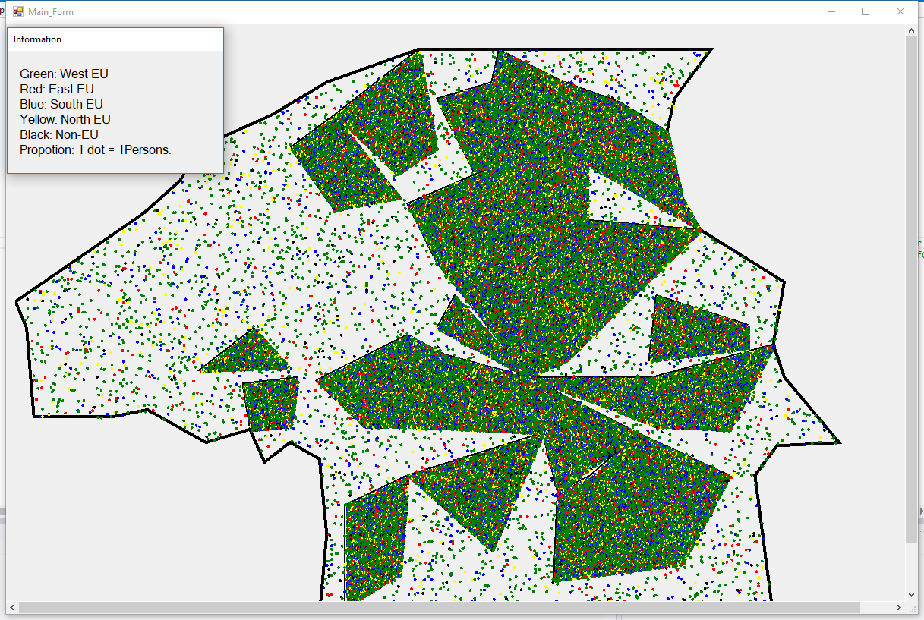
Eindhoven

Slide 5
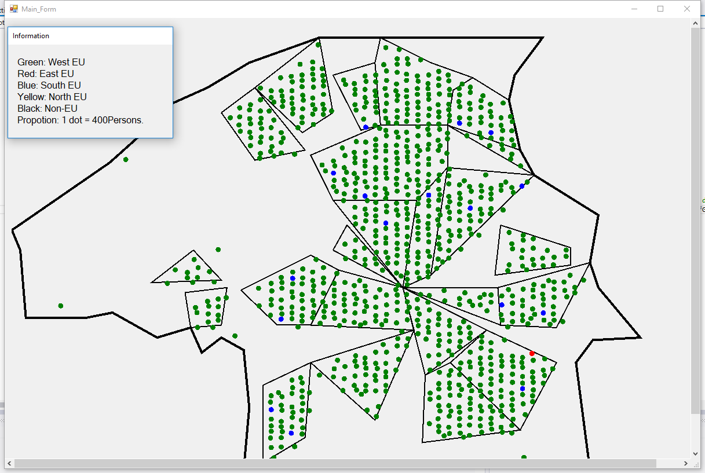
With proper aggregation

Slide 6
Problems
Radius of the dot
For better display, we want the distance between each dot is at least, say 70 pixels.
Then we would have the radius of the dot =
min(window width, window height) / 70 / zoom in level / 5
5 is here for some distance between other dots.
Zoom in level 1 means each dot = 1 person.
For better visibility, we give a minimum radius of the dot, for instance 4.

Slide 7
Problems
How many people = 1 dot
For better display, say we want the distance between each dot is at least 70 pixels.
Then we would have at most (window width / 70 / zoom in level) * (window height / 70 / zoom in level) = m dots.
Let n = total number of people, then there would be roughly n / m people in each dot.
We round the number, for instance, 12,390 will become 10,000; 103 will become 100 etc.
We apply the rounded number to the aggregation algorithm.

Slide 8
Problems
Where to place the dot (1).

Slide 9
Problems
Color of the dot

Slide 10

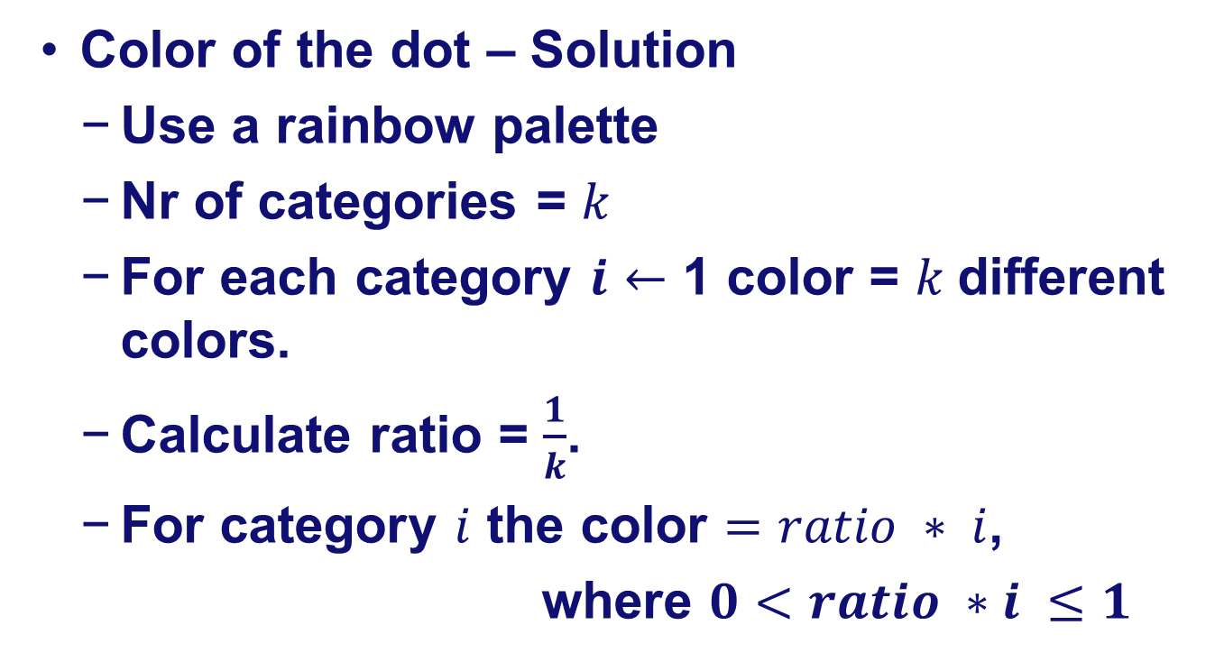
Problems
Color of the dot – Solution
Use a rainbow palette
Nr of categories = $k$
For each category $i$ $←$ 1 color = $k$different colors.
Calculate ratio = $\frac{1}{k}$.
For category $i$ the color $=ratio ∗ i$,
where $0<ratio ∗i ≤1$

Slide 11
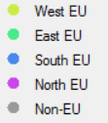
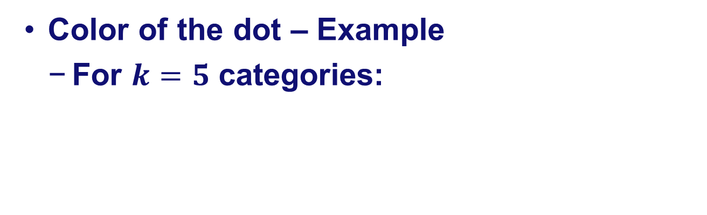
Problems
Color of the dot – Example
For $k=5$ categories:

Slide 12
Problems
Color of the dot – solution 1
50% green
20% blue
10% red
10% yellow
10% black

Slide 13
Problems
Color of the dot – solution 2
50% green / 60% green
20% blue /15% blue
10% red /10% red
10% yellow /10% yellow
10% black /5%black

Slide 14
Problems
Color of the dot – solution 3 (implemented)
50% green / root 60% green
20% blue / root 15% blue
10% red / root 10% red
10% yellow / root 10% yellow
10% black / root 5%black

Slide 15
Problems
Color of the dot – solution 4
50% green / root 60% green
20% blue / root 15% blue
10% red / root 10% red
10% yellow / root 10% yellow
10% black / root 5%black

Slide 16
Problems
Where to place the dot (2).
Choose the middle dot’s position
Dots are stored in a list
Average of all chosen dots’ positions

Slide 17
Problems
Where to place the dot (3).
Solve the overlapping

Slide 18
Running time
Radius of the dot = O(1)
How many people = 1 dot = O(1)
Where to place the dot = O(n)
Choose the middle point (O(1) * n)
Solve the overlap (O(n))
Color of the dot = O(n)
Solution 3 (O(n))
Total running time = O(n^2)
n = total number of people

Slide 19
Demo

Slide 20
Constraints
Data generation is slow O(N), where N = total number of people.
One time only, as long as the data.txt is not deleted.
Aggregation algorithm’s worst case Running time is O(N^3), where N = total number of people.
Each time when the proposition (number of people to 1 dot) changes.

Slide 21
Constraints
Special case 1
West EU (20%, Green)
North EU(20%, Blue)
East EU (20%, Red)
South EU (20%, Yellow)
Non EU (20%, Black)
people are distributed like this:
r1,r2,r3,r4,r5,r1,r2,r3,r4,r5 ….
Special case 2
West EU (96%, Green)
North EU(1%, Blue)
East EU (1%, Red)
South EU (1%, Yellow)
Non EU (1%, Black)
Special case …

Slide 22

Questions

